Slide 1
Choosing a Tech Stack
2023 Hyland Hackathon
Notes:
Hello, and welcome to the Choosing a Tech Stack Hackathon Session!

Slide 2

agenda
goals & considerations
technologies & frameworks
deployment
resources
closing thoughts
Notes:
Here’s what we’ll be covering today. We’ll talk about your goals and considerations, then get into some specific technologies and frameworks you’ll want to consider. We’ll also touch on deployment and show you some resources you can use to get your projects off the ground with whichever stack you choose. Finally, we’ll close things out with some concluding thoughts, and have some time for questions. Now let’s get into it!

Slide 3

goals for your hackathon experience
Win the competition?
Learn something new?
Expand existing knowledge?
Build something extraordinary?
Notes:
Before we talk specifics, let’s think about the big picture here. What are your goals at this hackathon?
Maybe you’re in it to win it.
Maybe you want to learn something new.
Maybe you know a lot, but you want to practice and expand your knowledge.
Maybe you want to start building something truly exceptional! It’s important to figure out what you want out of this experience. This will help guide you in your stack selection.

Slide 4

things to consider
Prior Knowledge
Industrial Usage
Mentor Experience
Ease of Onboarding
Notes:
There are some basic things you might want to consider when you’re choosing technology.
One – prior knowledge. Have you used any languages or frameworks in the past?
Two – industrial usage. Is this a tool that developers use in the real world? Is it valuable to learn? Is it well-documented?
Three – mentor experience. You’ll have the help of some awesome mentors throughout the weekend, but they might have specialized knowledge for certain tech.
Four – ease of onboarding. You only have 48 hours – you’ll want to think about the overhead of any stack. All of these things may come into play, or you may decide that they don’t matter all that much – just make sure to keep them in mind!

Slide 5
Technologies & Frameworks
platforms, languages, and more
Notes:
Alright, now we covered the big picture stuff. Let’s dive into some specific options.

Slide 6

web v. native
Native
Web
Desktop applications
Mobile applications
Games, audio, more
Websites (static or full-stack)
Progressive web apps
Almost anything
Used for specific cases in industry
Mentor support may be available
Recommended in specific cases
Mentor experience in many areas
Simple to start, valuable for the future
Highly recommended
Notes:
One of the basic decisions you’ll have to make is this: should your team’s project be a web application? Let’s start by talking about Non-Web applications.
These could be things like desktop applications, mobile applications, games, audio processors, and more.
These applications have some very specific use cases, but aren’t necessarily widespread. Mentors will be able to support you, but it depends on specifics. You may want to create a non-web application if you’re doing something specific, like creating a video game, working with VR, processing audio, or something like that. Basically, we recommend a Non-Web application if, and only if, you know what you’re doing.
Now on the other side of this, we have Web applications – these could be static HTML/CSS/JS websites or full-stack web applications – in general, you’ll be able to make a website instead of a desktop application. Your team could also create a progressive web app instead of a mobile application – PWAs allow you to use many native mobile features, but they can be much easier to get up and running.
Luckily, developers generally have some knowledge of web technologies. There is not much overhead, and a lot of applications now are surfaced through the web. In general, we highly recommend choosing a web stack.

Slide 7



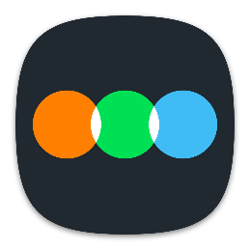

databases & the beauty of crud
4 Operations
Create
Read
Update
Delete
Types of Databases
SQL | NoSQL
Tables | Documents, Graphs
Structured Query Language | Various Languages
Rigid Schemas | Flexible Schemas
Older | Newer
MySQL, SQLite, PostgreSQL | MongoDB, DynamoDB, Redis
Notes:
Whether you decide to create a web-based project, or something else entirely, you will definitely want to consider using a database.
You can use a database to create a CRUD application – one that allows you to create, read, update, and delete data.
Using those four operations, you could create something like twitter, or Instagram, or letterboxd, or youtube! Starting from the basics and then trying innovate an idea on top of CRUD can be a great way to go.
If you choose to use a database, you’ll need to think about the type of database to use.
The two basics types are SQL and NoSQL.
SQL databases store data in a tabular format: rows and columns. NoSQL databases are much less structured.
SQL database use SQL – structured query language. NoSQL databases have a variety of different languages.
SQL databases have rigid schemas – they must be established ahead of time. NoSQL databases have much more flexible schemas.
SQL databases are older, and NoSQL is a little newer – this means that SQL DBs are well-established, but they also may not be as modern.
Some examples of SQL DBs are MySQL, SQLite, and PostgreSQL. Some examples of NoSQL DBs ae MongoDB, DynamoDB, and Redis.

Slide 8








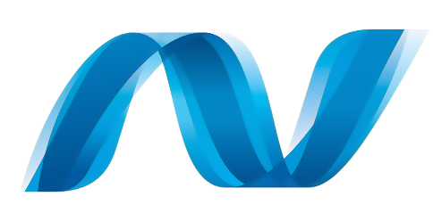


back-end web frameworks
Python
Django, Flask
Java
Spring Boot
JavaScript
NodeJS + Express
Ruby
On Rails
C#
ASP.NET
Notes:
Now let’s discuss some frameworks that are specific to the web. These will allow you to build web servers.
If you know JavaScript, using NodeJS and Express is the standard way to make a simple web server.
If you know Python, there are two basic frameworks – Django, and Flask.
If you know Java, there’s Spring Boot.
If you know C#, there’s ASP.NET
If you know Ruby, there’s Ruby on Rails.
One of our main recommendations is NodeJS and Express – it’s one of the lowest overhead server frameworks, and there’s a lot of great support for it.
We also recommend Flask if you know Python – it’s more lightweight than Django, and requires very little overhead.

Slide 9
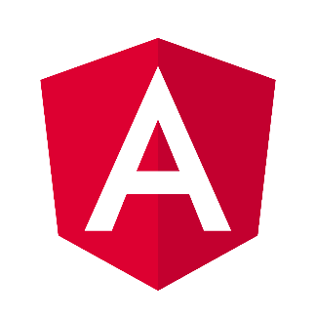





front-end web frameworks & tools
JavaScript/TS
React
EJS
Svelte
Vue
Ember
Angular
C#
Blazor
<%= EJS %>
Notes:
Now we’ve talked about the back-end, let’s flip and talk about the front-end!
If you want to use JavaScript or TypeScript, there are a ton of options available. All have their own unique properties, but any of them are worthwhile to learn and use.
If you want to use C#, you can use Blazor.
We recommend sticking with JavaScript – React is very standard in the industry. It is easier to pick up than other frameworks like Angular, but it is incredibly powerful.
For a more simplified way of doing things, you could try EJS – it’s actually a templating language, so it’s more limited, but it’s even easier to get an application running.

Slide 10


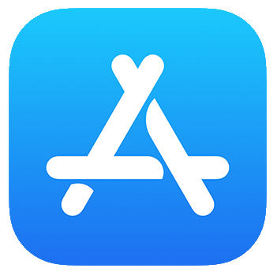

deployment
Web
Native
Host your website’s files on a web server
Replit does this for you as you make changes and hit Save
In the software industry, we automate this with a Continuous Delivery pipeline
Requires an Apple or Android developer account
Must design and compile your app for specific platforms
Must submit to app store(s) for approval
Notes:
When your project is in a state where you’re ready to show it off, it’s time to deploy! To deploy just means to make available for people to try on their device(s).
Deploying a web app can be simple.
It typically involves copying the files for your website onto a web server, thus making it accessible to users via a web browser on their computer or phone.
Web-based IDEs (like Replit) do this automatically every time you hit Save. Think about what is happening when you see your code changes reflected in the preview in your browser.
You can also Publish your Repl more officially by following the Sharing Your Repl link in the Resources.
Deploying a native app can be more complex, as it involves building and compiling the app for specific platforms and submitting it to app stores for distribution.
You are also required to sign up for a developer account, which is not free.
An advanced topic for a future session is continuous deployment, which can be set up to automatically deploy your site every time a code change happens!
This is a big part of what DevOps is.
In general, deploying a web app can be relatively straightforward, while deploying a native app is more complex and may require more time and resources.
In this hackathon there are no specific requirements around deployment. Any way you want to share your creation with us is fine!

Slide 11

general advice
Web Stacks
Express + EJS
MERN
Flask + MySQL
Django + SQLite
If you’re not sure: make a web app
Leverage your team’s knowledge
Or choose recommended tech
Choose the simplest option
Find boiler-plate examples
Notes:
Now here’s some general advice you might want to consider.
We said this before, but if you’re not sure about what to do: try a web app! It’s easy to start, used in industry, and generally known by most mentors.
You should consider what your team already knows – with only 48 hours, any pre-existing knowledge can make it much easier. If you’re not using a stack your team already knows, use some of the tech stacks we’ve already recommended. Or, completely ignore that if you want! But know that we might not be able to support you as much.
If you’re struggling to choose, consider the simplest option. Again, it’s only 48 hours.
For help jump starting your project, it’s totally cool to use boiler-plate examples! Just make sure you understand the code you’re pulling into your project.
If you are using a web stack, it is highly recommended to use one that has already been established. You can feel free to mix and match if you really want, but it might be more difficult to find support. Some standard web stacks include Express & EJS (powered by Node+JS), MERN (MongoDB, Express, React, Node), Flask + SQLite (powered by Python), and Django + MySQL (also powered by Python).

Slide 12
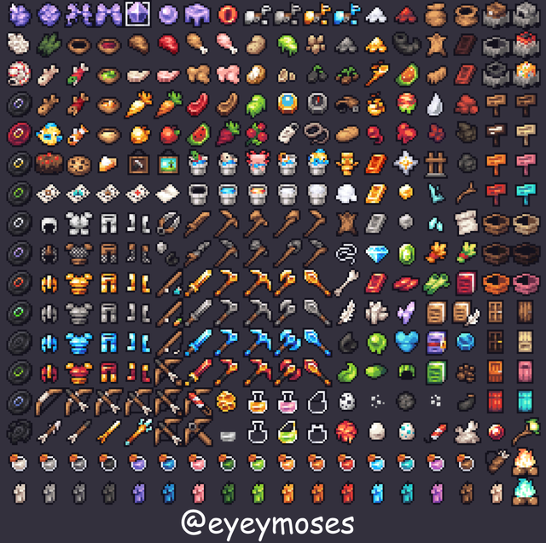
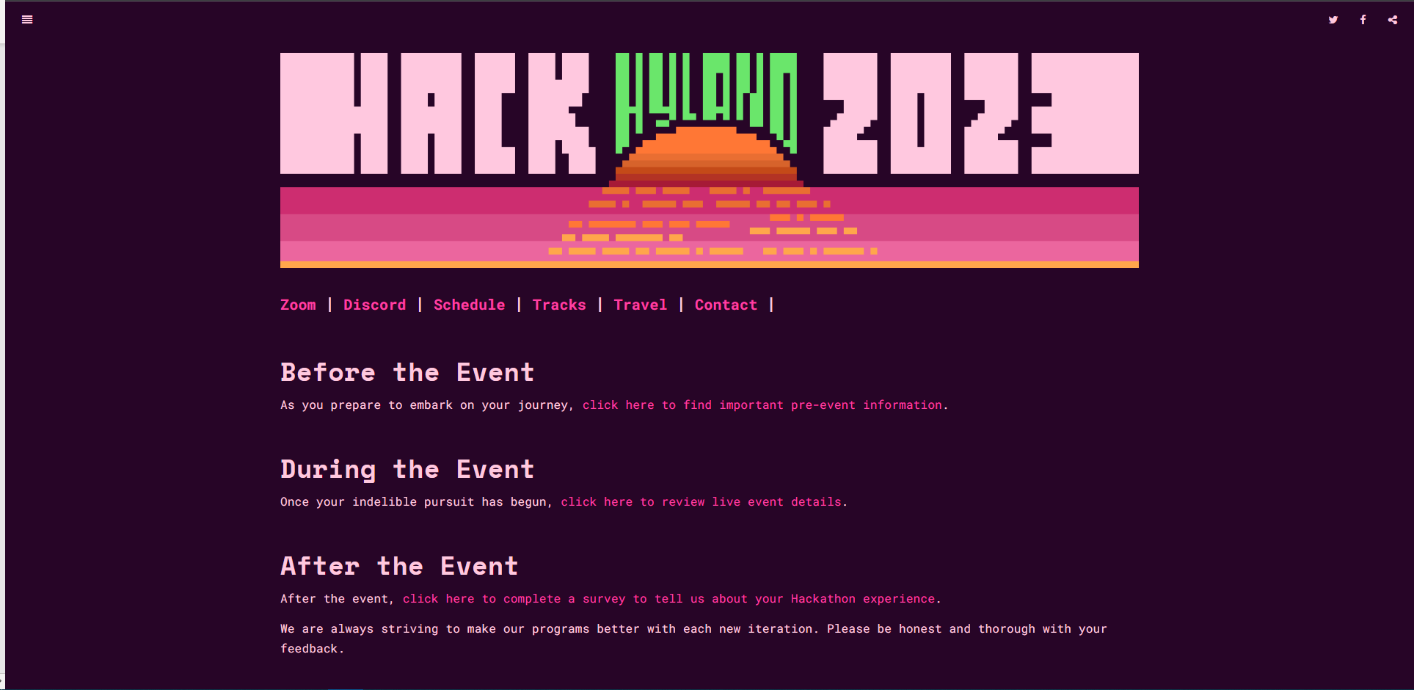
resources
Articles, Tutorials, and Examples
Mentor Skills and Shifts
tinyurl.com/
hackhyland2023
Notes:
Now let’s take a minute to look at some resources. Remember, you can go to tinyurl.com/hackhyland2023 to get to our Hackathon Website – there is a ton of useful stuff there. Navigate to Workshops & Sessions -> Choosing a Tech Stack for links to these resources and mentor information.

Slide 13
closing thoughts
Use
Your
Resources
You Will
Learn
No
Wrong
Decisions
Strong
Start
Notes:
Now for some important takeaways from this session.
Start strong! Think like an architect and decide your stack, then stick with it and jump in as fast as you can. Then…
Use your resources! Find tutorials, boiler-plate code, and more. These can help a lot when you’re getting your project off the ground.
Keep in mind that you will learn, one way or another! There’s always going to be learning to do… you’ll run into problems, solve them, then find more problems… it’s all part of the experience.
And finally, there are no wrong decisions here! You’re going to learn, so even if you choose a stack that isn’t perfect, you’ll now have that experience. So just do your best, and try to have some fun along the way.

Slide 14
Questions?
now’s the time
Notes:
Now we have time for any questions you may have.

Slide 15
Thank You
2023 Hyland Hackathon
Notes:
Thank your for attending this session, and best of luck with your projects!

